Slide 1
Building and Deploying React JS
Jason Monroe - 688776

Slide 2
Session Objective:
At the end this 30 min session, you will be able to
Build and deploy a React app to GCP App Engine or Cloud Foundry

Slide 3
Who will be Benefitted ?
Associates
Management
Clients

Slide 4
Key Topics
Production Build
Deployment

Slide 5
Production Builds

Slide 6
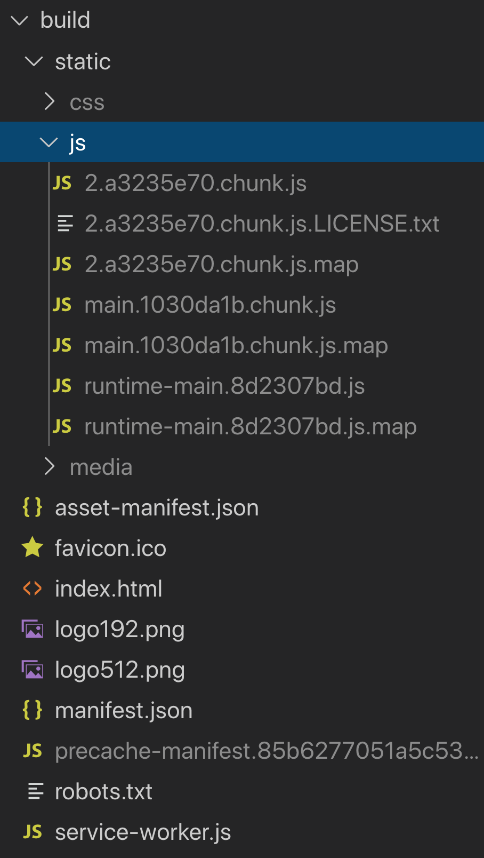

React JS Production Builds:
Creates optimized production build in build folder
Static files placed in static subfolder
Minimizes js files into main and chunk js files
Map files used to map minified files back to originals in browser developer tools for debugging, etc.

Slide 7
Deployment

Slide 8
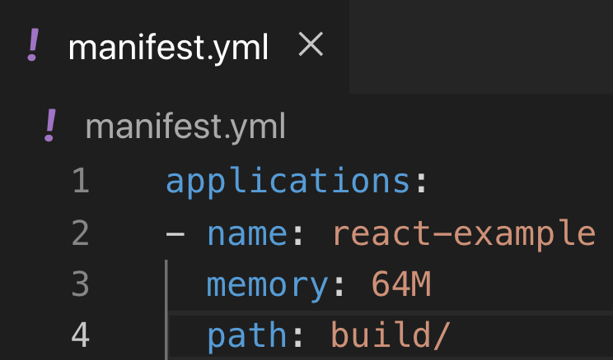
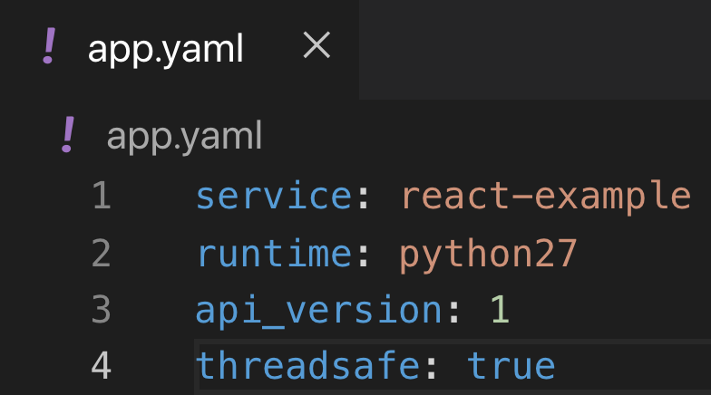
Deployment
Files in build folder are served as-is
Cloud provider just needs to know that it is a static deployment and where to find the files
PWS
GCP

Slide 9
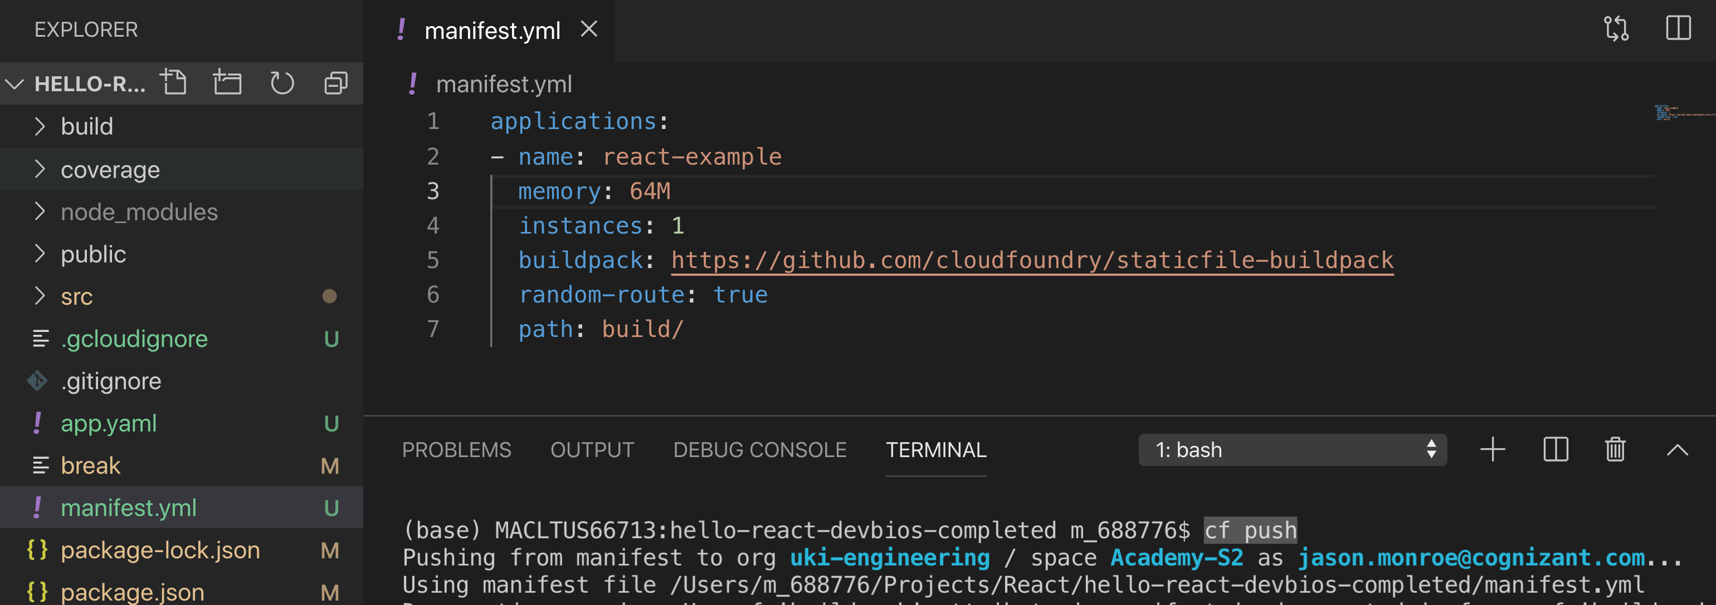
PWS
manifest.yml in root
Path to build folder
cf push (cloud foundry cli must be installed)

Slide 10
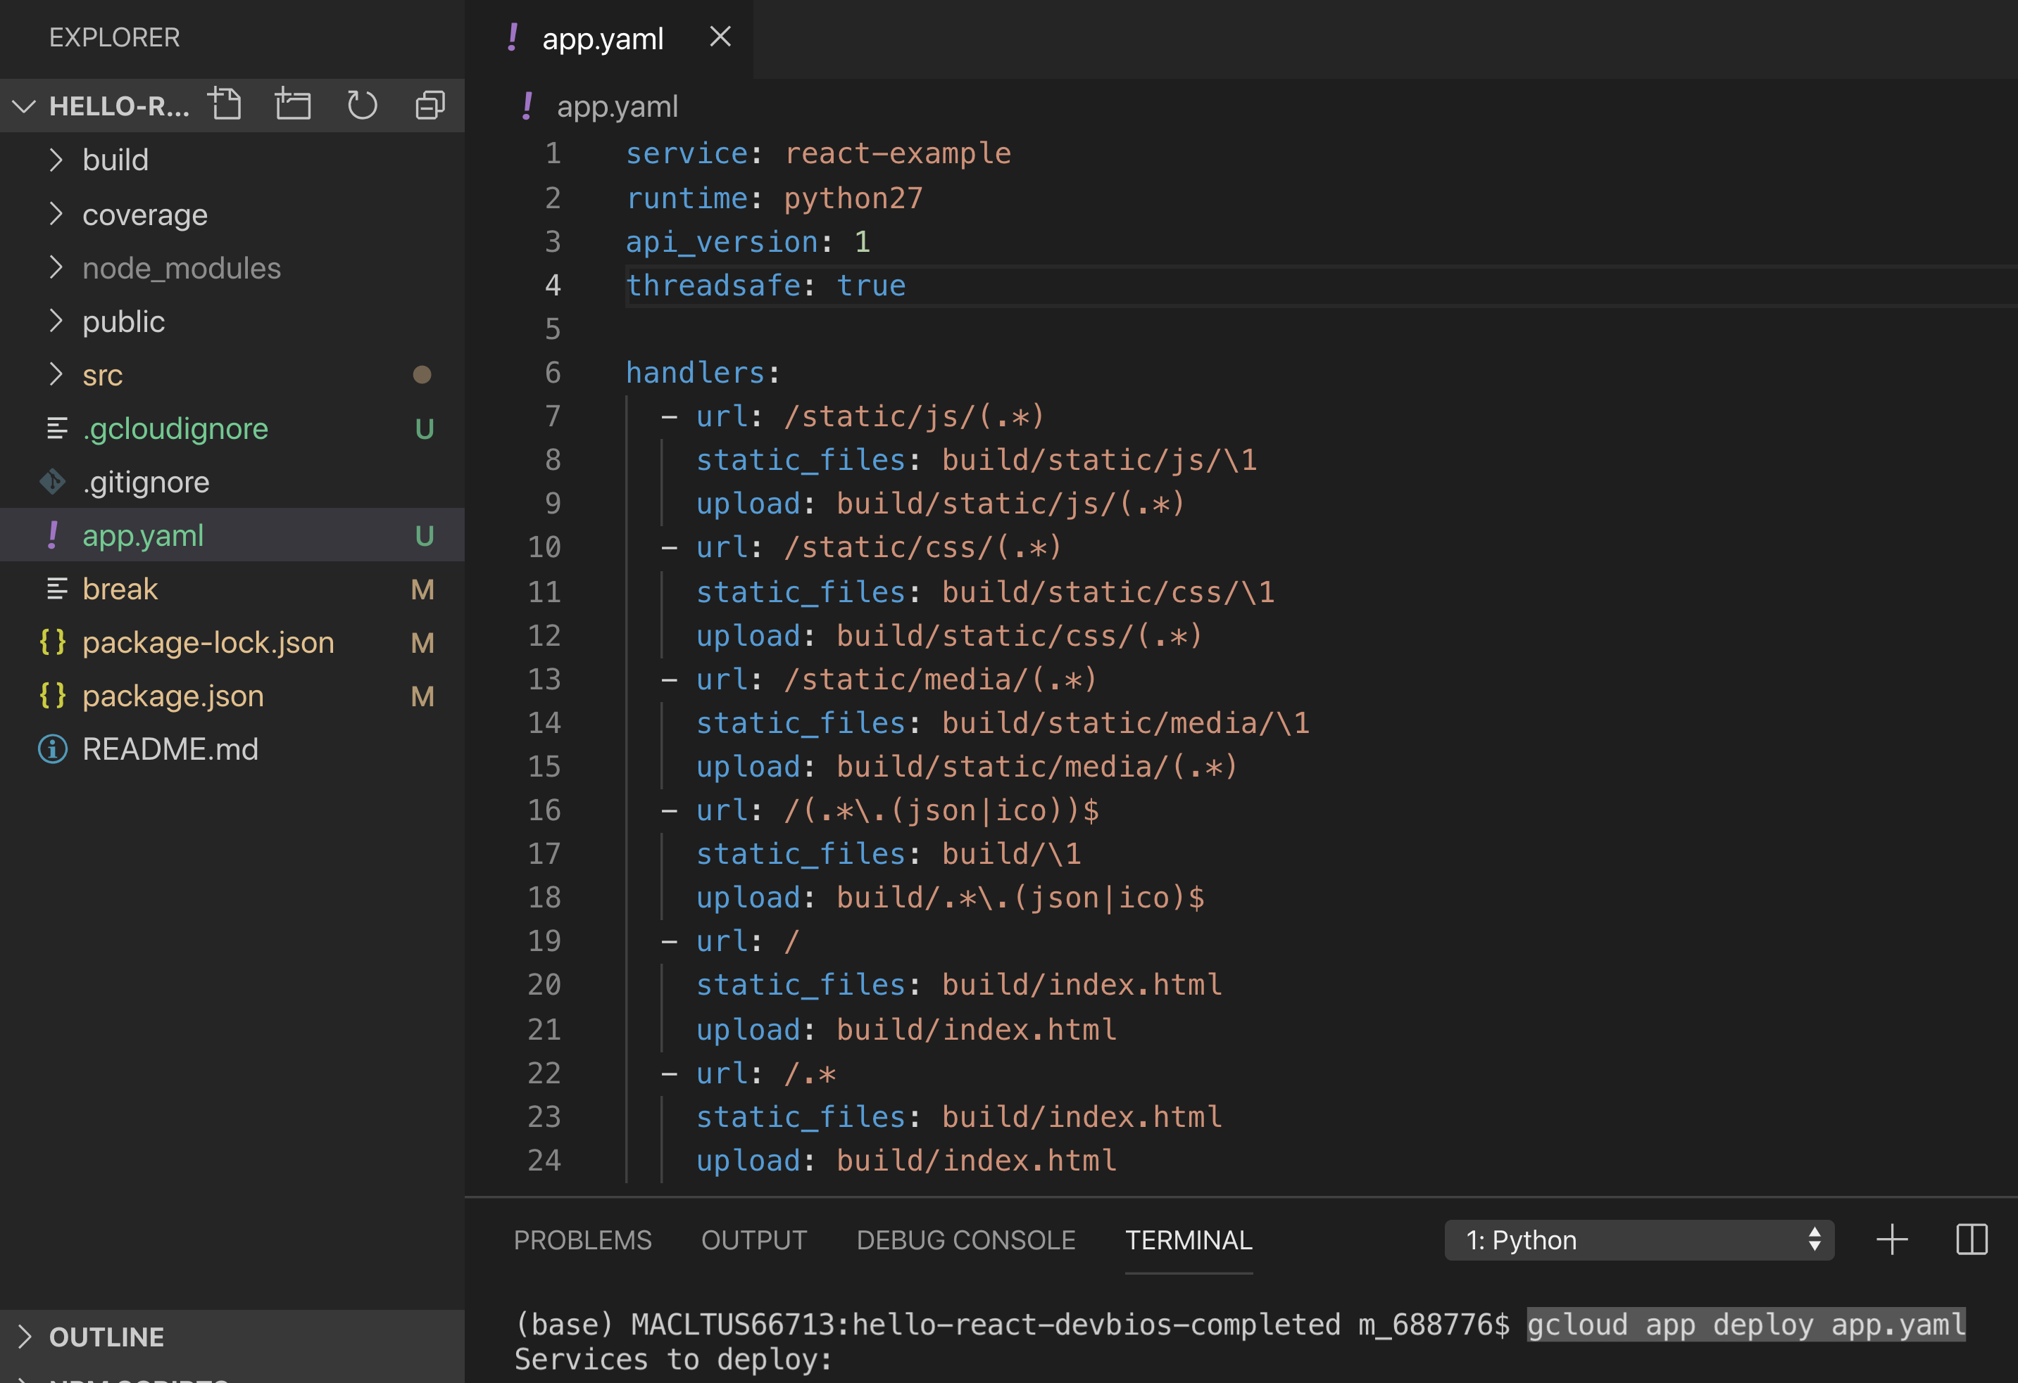
GCP App Engine
App.yaml in root
Python runtime (nodejs will trigger dev build)
Set up handlers to direct app engine to file locations
gcloud app deploy app.yaml (must have gcloud sdk installed)

Slide 11
Review
npm run build
Serve build folder as static in cloud provider

Slide 12
Session Objective:
At the end this 30 min session, you will be able to
Build and deploy a React app to GCP App Engine

Slide 13
Thank You

